Slide 1

Design Thinking
STEAM MAKERSPACE

Slide 2









How Does it Work? Simplified
Ask
Pose Open-ended Questions
Improve
Reflect, how can you make your design better?
Design
Learning
Process
Imagine
Brainstorm & Make
Predictions
Create
Build & test your design
Plan
Design solution & Sketch diagram

Slide 3



How Does it Work? Extended
Learn
Play
Reflect
Observe
Ask Questions
Design
Learning
Process
Research
Plan
Present
Create

Slide 4









They become systems thinkers
They become hackers and rebels
They become explorers
They grow more empathetic
What Happens when students embrace design thinking?
They become unabashedly different
They become problem solvers
By John Spencer, “Why Every Classroom Should be a Makerspace”
They make connections between ideas
They think divergently
They learn to take creative risks
They are ready for the creative economy

Slide 5

Where to Begin…
“You don’t have to know how to do everything in the makerspace. You just have to know how to learn and to help others learn how to learn.”
Who drives the projects?
Can teachers be makers?
How can we all be learners and teachers in a makerspace?
Can students be teachers?
Nick Provenzano
“The Teacher-Maker Show”
Do teachers need to be experts on everything in the makerspace?
Makerspaces are not just about using technology. Robotics and knitting both have a role in the makerspace.
Makerspaces are about having a space to create. The learner drives the learning, but others can help.

Slide 6


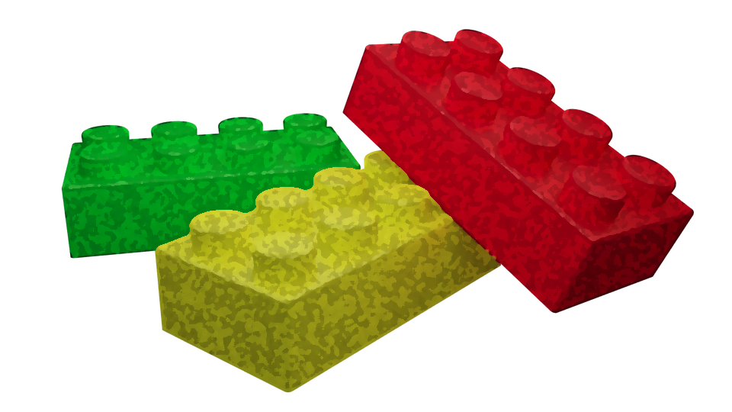
Learners construct knowledge to make sense of the world around them.

Slide 7
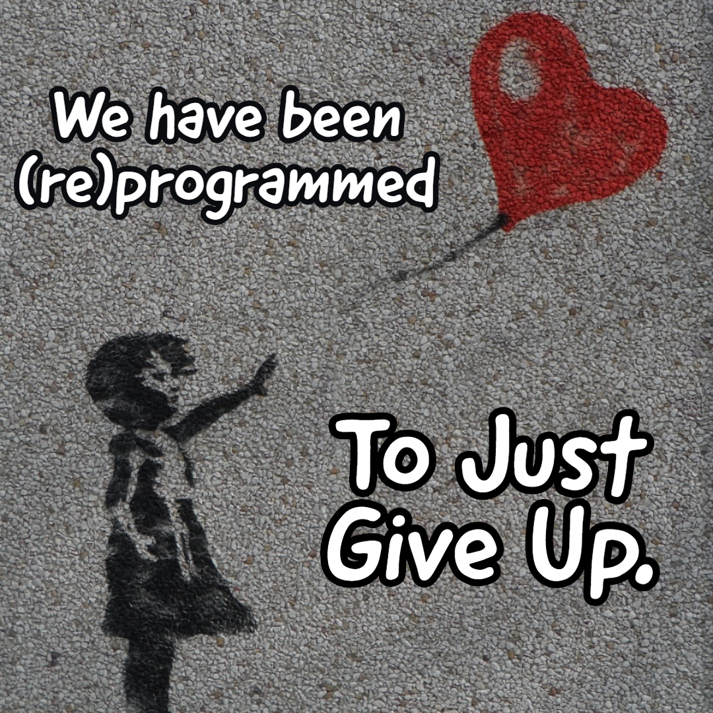
Notes:
-Talk about students on Math problems who give up after reading it, and workers who don’t even attempt to fix something.
-”Would you just sit in an escape room for an hour doing nothing if you didn’t get a puzzle?”

Slide 8

Why is problem solving so important?
Notes:
Why is problem solving key for kids? How does design thinking help develop problem solving skills?

Slide 9

Let’s Problem Solve!!!

